Slide 1
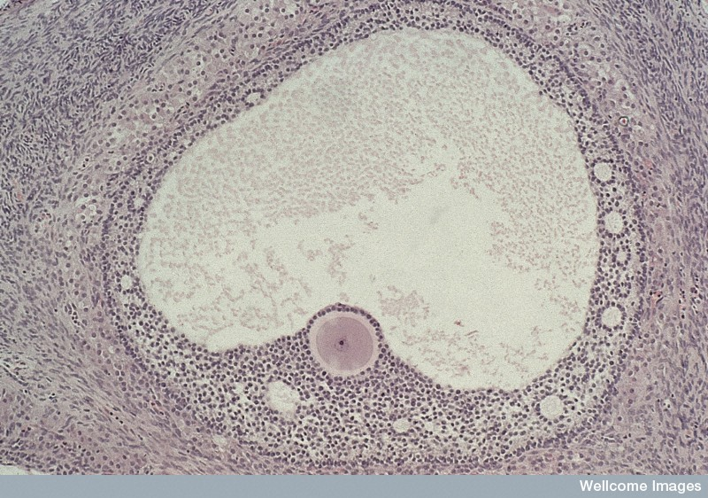
Fluid-filled space
Zona pellucida
Pronucleus Corona radiata

Slide 2
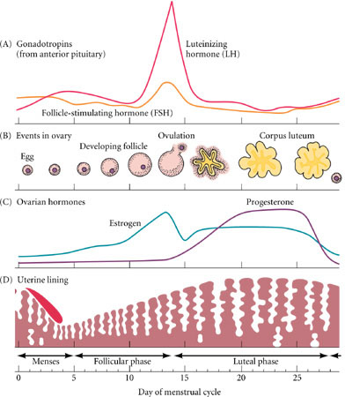

Slide 3
Relative levels of estrogen, progesterone, LH and FSH during the 28-day cycle
Ovulation
Hormone
level
Progesterone
Estrogen
LH
FSH
Follicular
phase
Ovulatory
phase
Luteal
phase

Slide 4
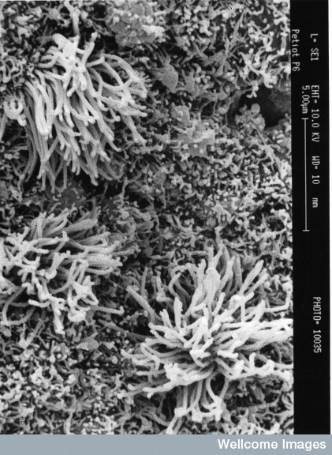
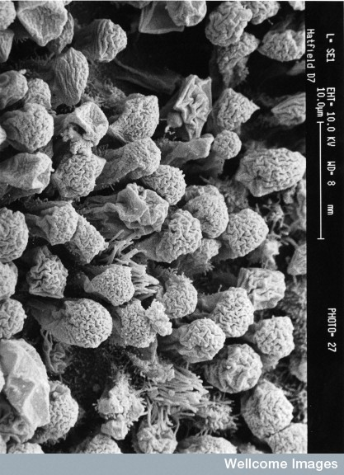
Changes to endometrium due to oestrogen and progesterone

Slide 5
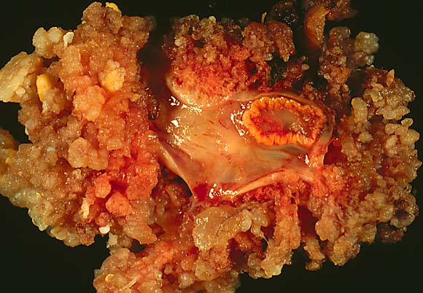
Corpus luteum
Ovary

Slide 6
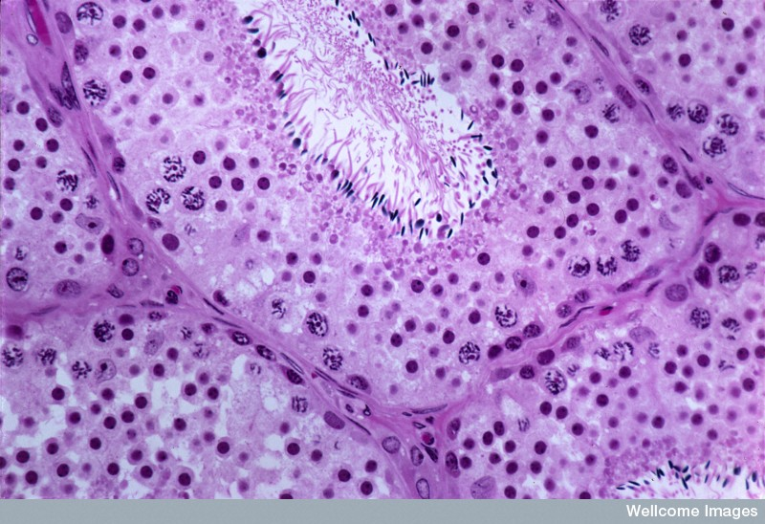
FSH stimulates the formation of sperm
LH stimulates the production of testosterone

